Slide 1
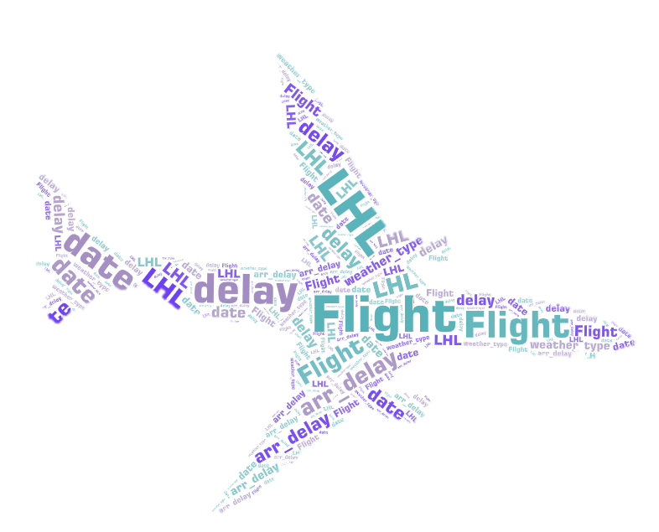
Mid – Term Project Report
Predicting Flight Delays
Gianluca Fuoco
& Jingyun Li
2022-06-10

Slide 2
https://www.ypppt.com/
01
Data Gathering
Exploratory Data
Analysis
DIRECTORY
02
03
Feature Engineering
04
Modeling

Slide 3
01
Data Gathering

Slide 4

Data Gathering
Flight_Samples(100,000 points)
Flight_Tests
From LHL
From LHL
Weather_Event (2016-2021)
From Kaggle
Tool used: VS Code editor & SQL

Slide 5
Data Gathering
t
d
t
d
t
d
t
d

Slide 6
Exploratory Data
Analysis
02

Slide 7
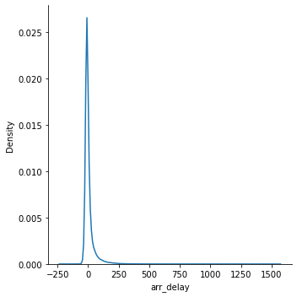
Exploratory Data Analysis
Test The Hypothesis That The Delay Is From Normal Distribution
The delay is a normal distribution however there is a tail on right side, that means there are some very far-flung delays.
we don't see a tail on the others side, that means flights don't come to ahead of time.

Slide 8
Exploratory Data Analysis
States Covering 50% Air Trafic
state | Flight | %
CA | 10885 | 10.885
TX | 9793 | 9.793
FL | 7178 | 7.178
IL | 6332 | 6.332
GA | 5304 | 5.304
NY | 5273 | 5.273
NC | 4662 | 4.662
CO | 3950 | 3.950
California
Texas
Florida
Illinois
Georgia
New York
North Carolina
Colorado
Notes:
https://www.ypppt.com/

Slide 9
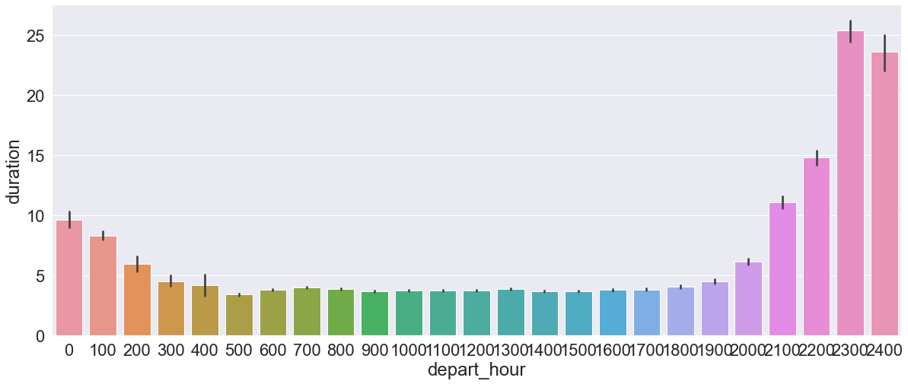
Exploratory Data Analysis
When do most 'LONG', 'SHORT', 'MEDIUM' haul flights take off?
LONG; Any flight longer than seven hours is considered a “long-haul” flight.
MEDIUM; Medium-haul is defined by flights lasting between 3-6 hours.
SHORT; Short-haul is a flight lasting anywhere from 30 minutes to 3 hours.

Slide 10
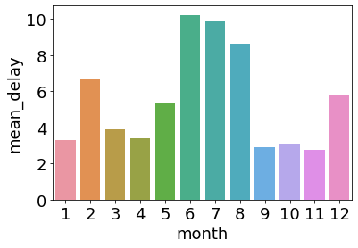
Exploratory Data Analysis
Median Monthly Delay During The Year
During June to August has most delays of the year.
Guess the reason:
Higher traffic ( people travail during summer).
Higher chance of thunderstorm.

Slide 11
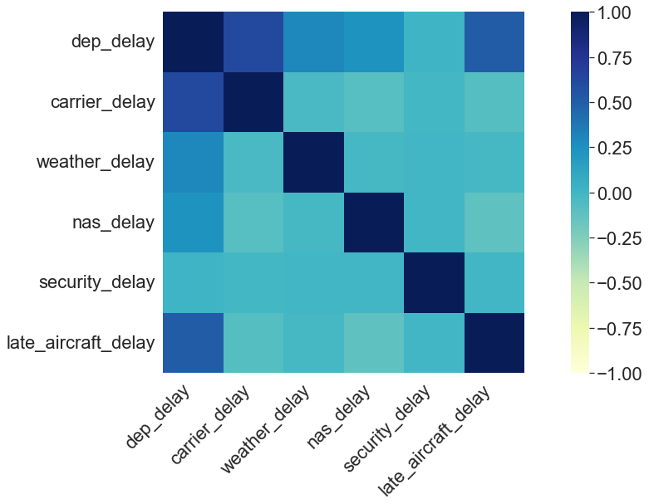
Exploratory Data Analysis
Delay Created Before Departure
& Correlation Between All Delay
The average percentage of arrival delays is 35 %.
The average percentage of delays that is already created before departure is 34 %. The average percentage of flights that depart late and arrive late 25 %.
That means airlines able to lower the delay during flights.

Slide 12
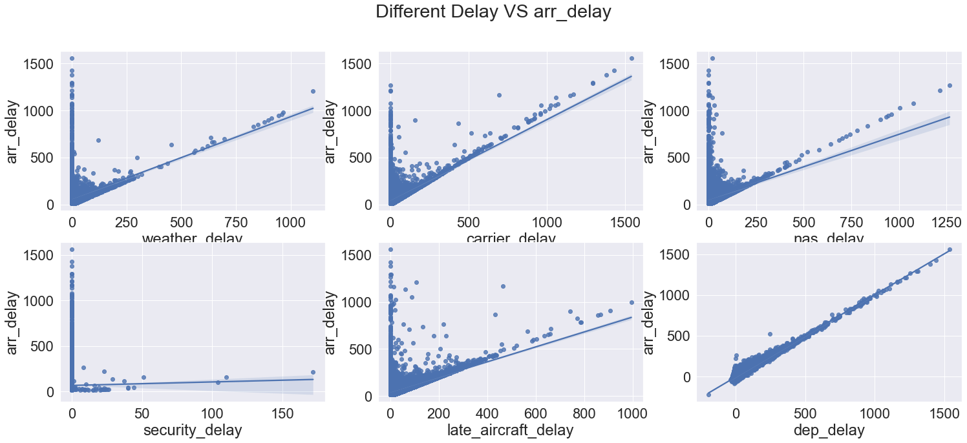
Exploratory Data Analysis

Slide 13
03
Feature Engineering

Slide 14

Feature Engineering
t
a
t
d
t
d

Slide 15
Feature Engineering

Slide 16

Feature Engineering
t
t
d。
d。

Slide 17
Feature Engineering
t
d
t
d
t
d
XX集团业务下滑。2017年该客户完成销售1300万元，而2018年由于新领导、新政策，对其铁牌单位进行大整顿和调整，使XX销售业务大幅度下降，其他铁牌客户的业务也受到不同程度影响；

Slide 18
04
Modeling

Slide 19




Modeling
t
d
t
d
t
d
t
d

Slide 20

Modeling
t
d
t
d
t
d
t
d

Slide 21
Merci
Thanks
Gianluca Fuoco
& Jingyun Li
2022-06-10

